Slide 1
Deterministic Multi-Modal Sensor Ingestion and Actuation via Holoscan-Integrated Switched Fabrics
Jim Reardon, One Stop Systems, Inc.

Slide 2

Prior Work
This hardware architecture builds directly upon prior development of high-speed switched fabrics, along with established software SDKs, hardware interfaces, and military open system standards.
This prior work was presented at the 2025 Ground Vehicle Systems Engineering and Technology Symposium (GVSETS) titled "Sensor Latency Advantage in PCI Express Switched Fabrics”
A special thanks to our our sponsors here in Michigan, and to the NDIA for promoting community forum supporting innovation.

Slide 3
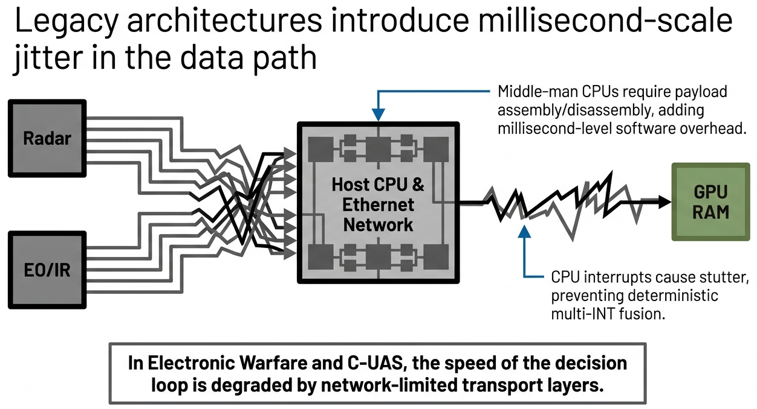
The Problem

Slide 4
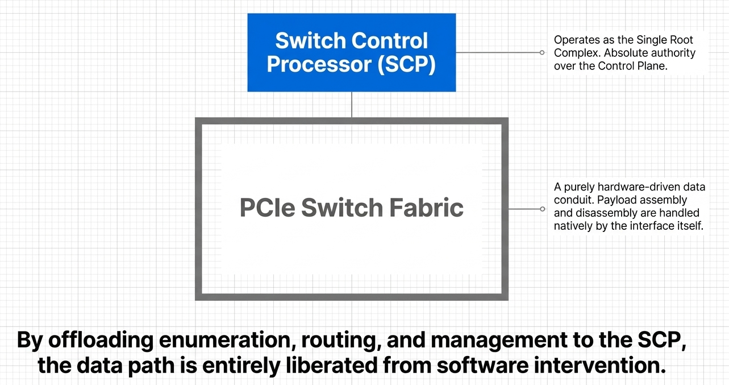
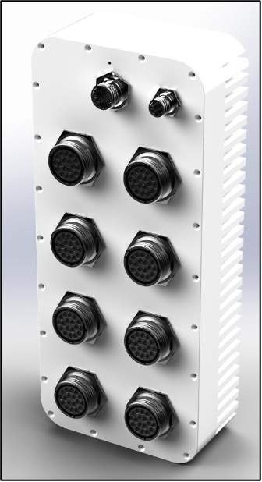
Switch Control Processor

Slide 5
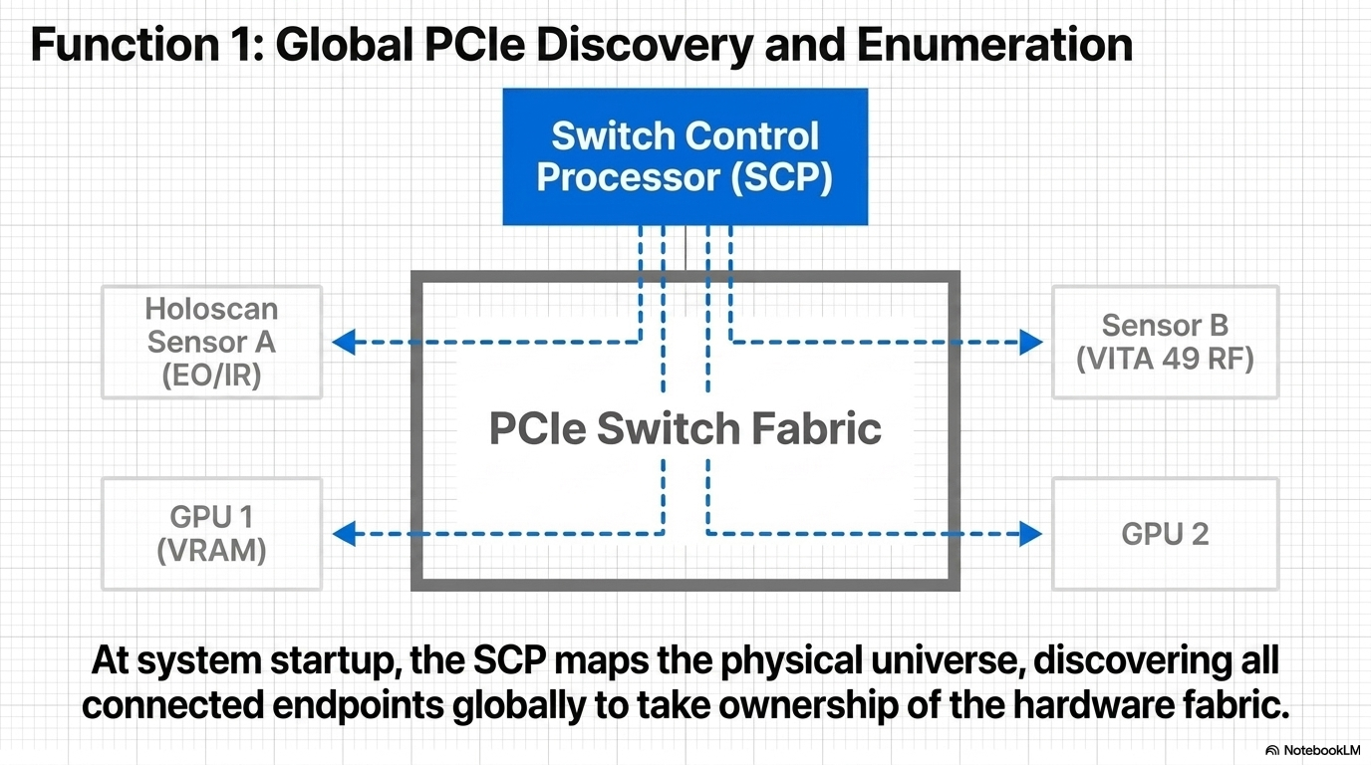

Slide 6
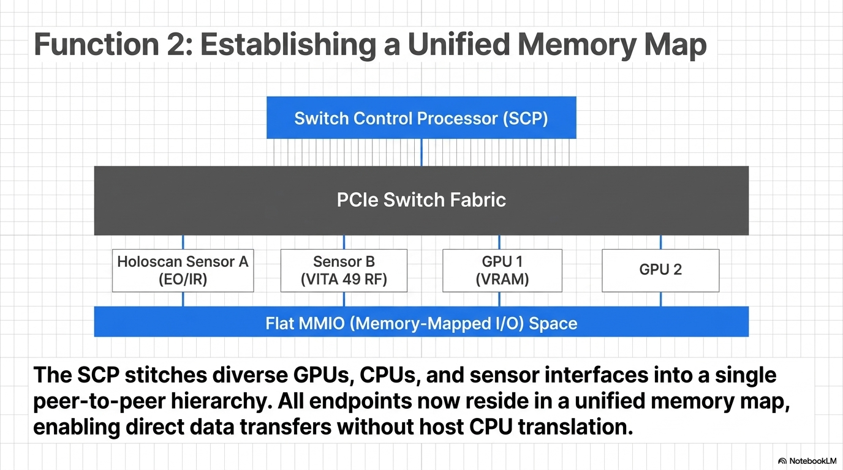

Slide 7
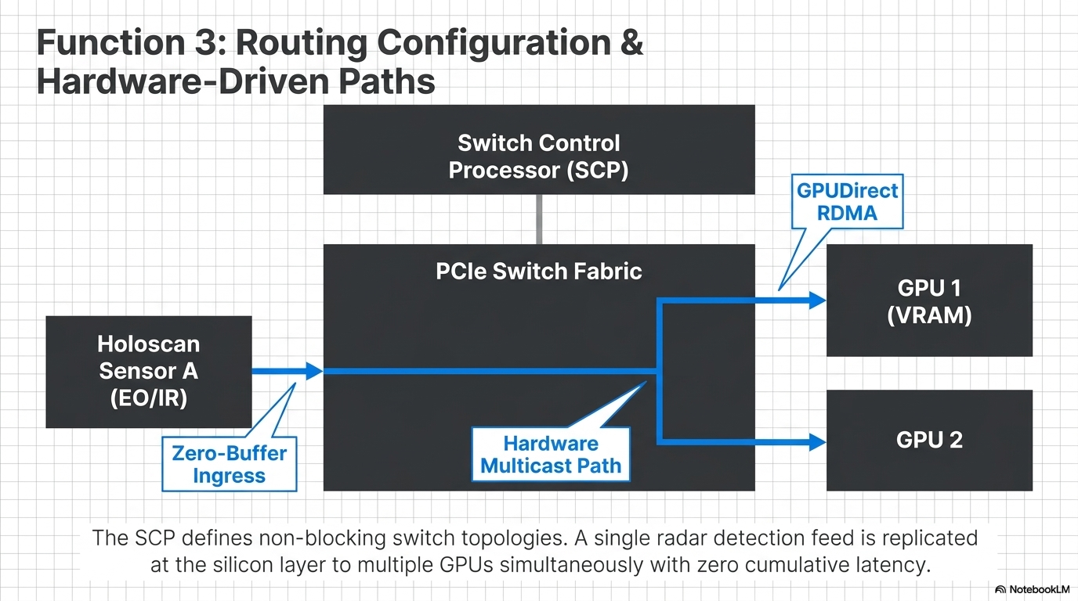

Slide 8
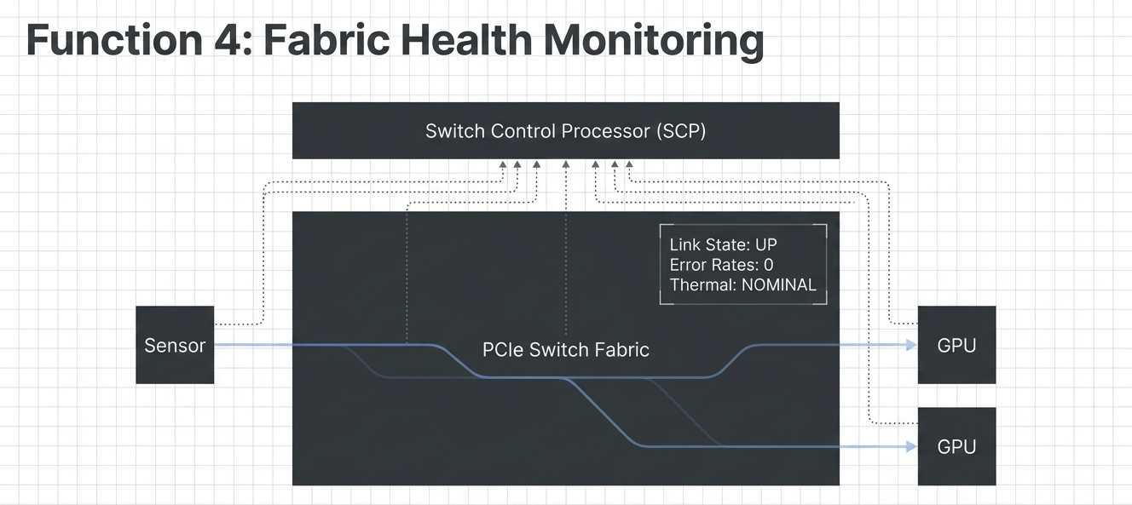
SCP continuously monitors the PCIe Switch Fabric, acting as the central authority for overall system health and performance. It maintains a stable environment for deterministic and uninterrupted throughput at fabric rates.

Slide 9
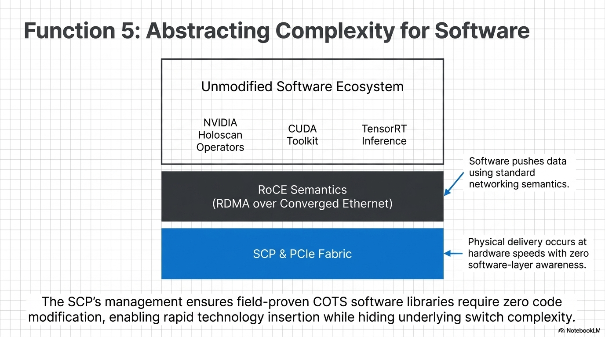

Slide 10
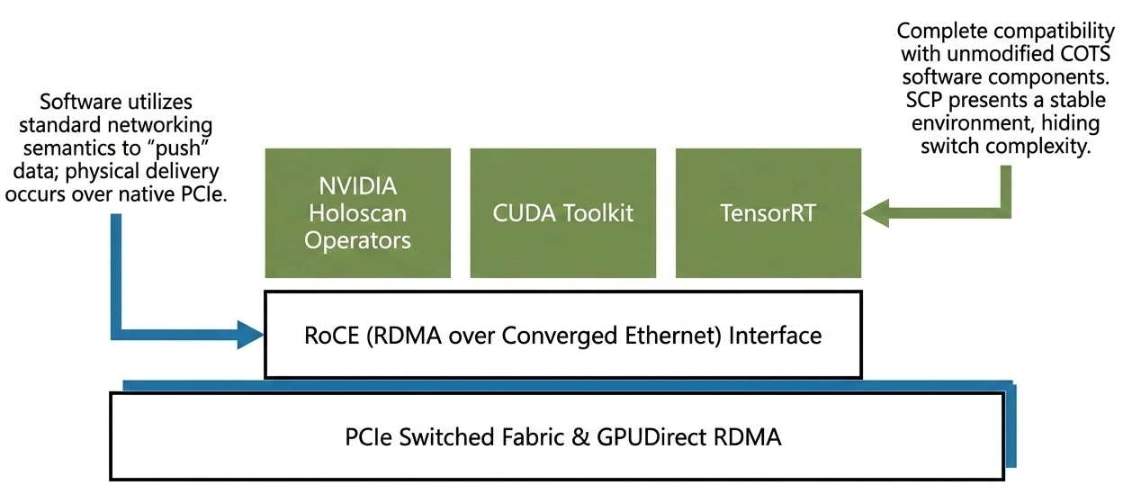
Standard Software, Protocols, and APIs

Slide 11
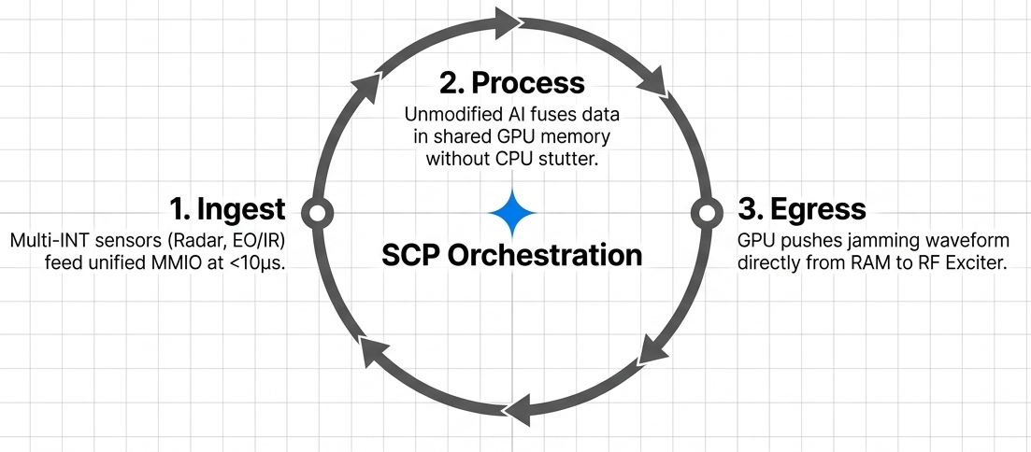
Sensor-Effector Symmetry (Objective)
PCIe is symmetric and bidirectional. More than an ingest tool, it can close the sensor-effector loop at microsecond latency and offers enormous throughput.

Slide 12
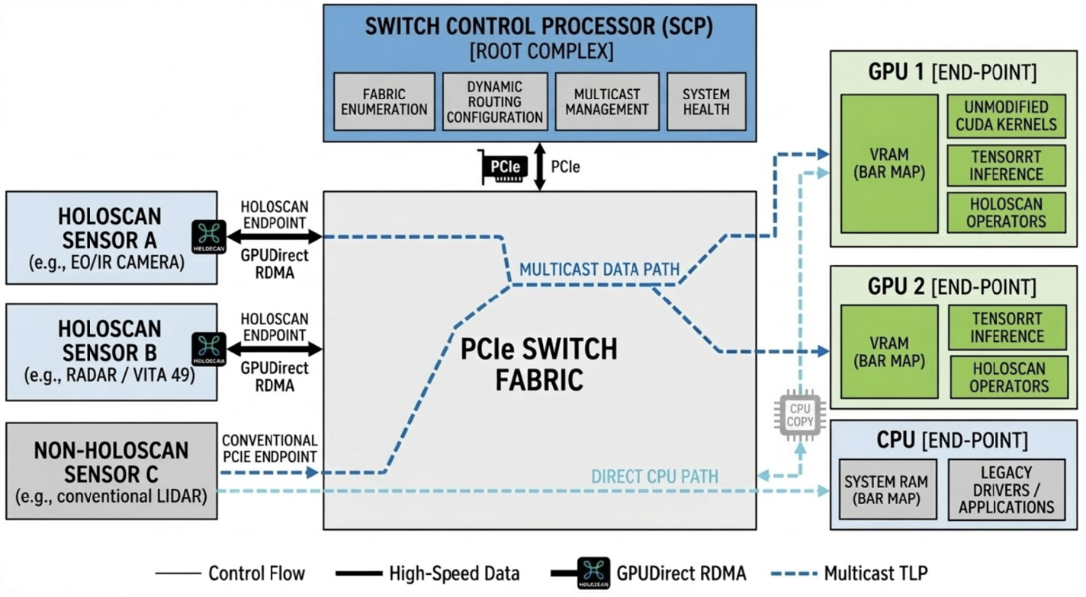
Summary

